Slide 1

Demand, Supply, and Market Equilibrium

Slide 2
Firms and Households: The Basic Decision-Making Units
firm An organization that transforms resources (inputs) into products (outputs). Firms are the primary producing units in a market economy.
entrepreneur A person who organizes, manages, and assumes the risks of a firm, taking a new idea or a new product and turning it into a successful business.
households The consuming units in an economy.

Slide 3
Input Markets and Output Markets: The Circular Flow
product or output markets The markets in which goods and services are exchanged.
input or factor markets The markets in which the resources used to produce goods and services are exchanged.

Slide 4

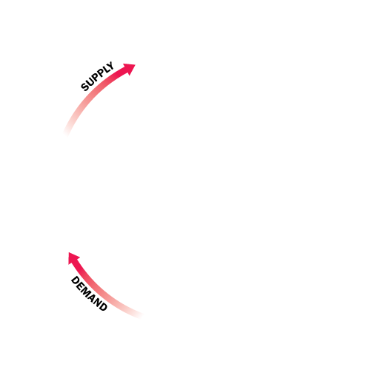
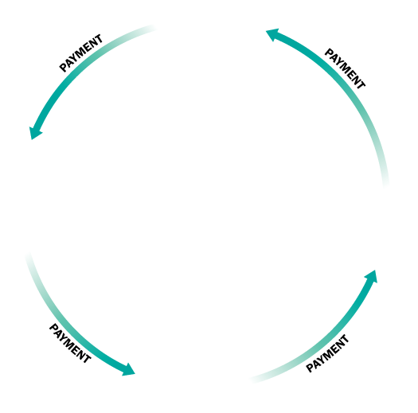
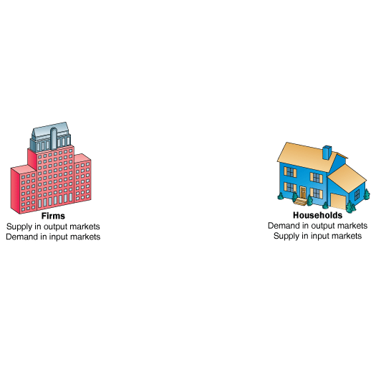
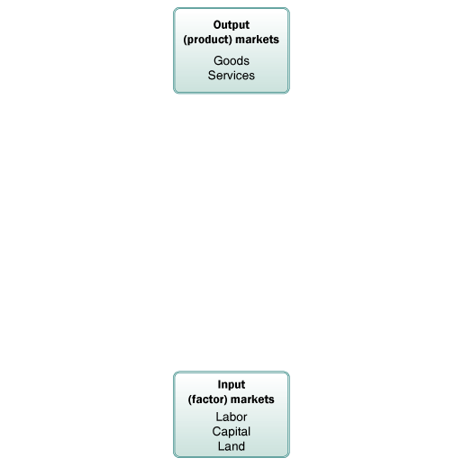
FIGURE 1 The Circular Flow of Economic Activity
Here goods and services flow clockwise: Labor services supplied by households flow to firms, and goods and services produced by firms flow to households.
Payment (usually money) flows in the opposite (counterclockwise) direction: Payment for goods and services flows from households to firms, and payment for labor services flows from firms to households.

Slide 5
labor market The input/factor market in which households supply work for wages to firms that demand labor.
capital market The input/factor market in which households supply their savings, for interest or for claims to future profits, to firms that demand funds to buy capital goods.

Slide 6
land market The input/factor market in which households supply land or other real property in exchange for rent.
factors of production The inputs into the production process. Land, labor, and capital are the three key factors of production.
Input and output markets are connected through the behavior of both firms and households. Firms determine the quantities and character of outputs produced and the types and quantities of inputs demanded. Households determine the types and quantities of products demanded and the quantities and types of inputs supplied.

Slide 7
Demand in Product/Output Markets
A household’s decision about what quantity of a particular output, or product, to demand depends on a number of factors, including:
The price of the product in question.
The income available to the household.
The household’s amount of accumulated wealth.
The prices of other products available to the household.
The household’s tastes and preferences.
The household’s expectations about future income, wealth, and prices.

Slide 8
quantity demanded The amount (number of units) of a product that a household would buy in a given period if it could buy all it wanted at the current market price.

Slide 9
Changes in Quantity Demanded versus Changes in Demand
The most important relationship in individual markets is that between market price and quantity demanded.
Changes in the price of a product affect the quantity demanded per period. Changes in any other factor, such as income or preferences, affect demand. Thus, we say that an increase in the price of Coca-Cola is likely to cause a decrease in the quantity of Coca-Cola demanded. However, we say that an increase in income is likely to cause an increase in the demand for most goods.

Slide 10
Price and Quantity Demanded: The Law of Demand
demand schedule Shows how much of a given product a household would be willing to buy at different prices for a given time period.
demand curve A graph illustrating how much of a given product a household would be willing to buy at different prices.

Slide 11

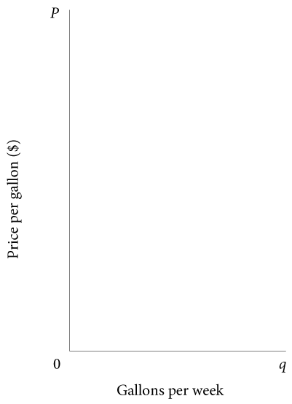

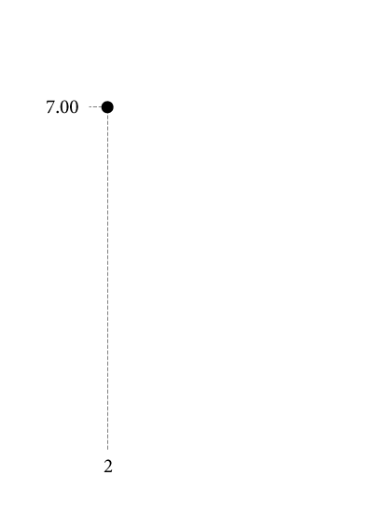
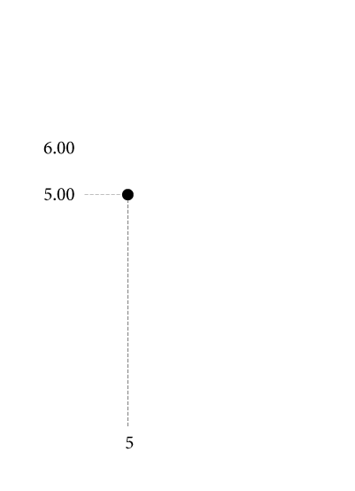
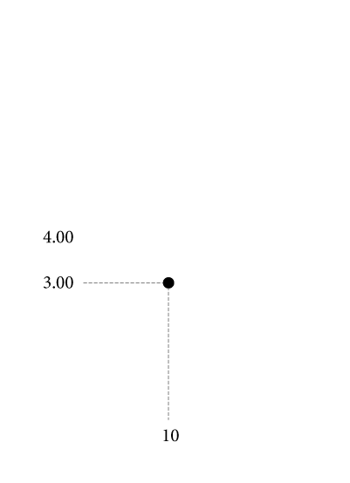
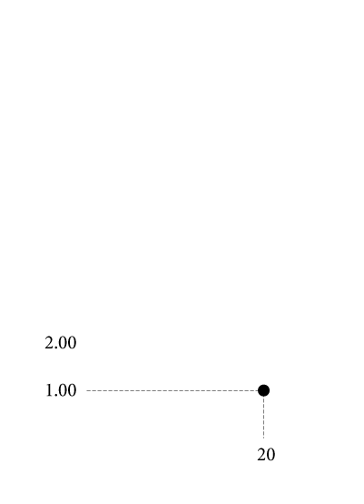





TABLE 3.1 Alex’s Demand Schedule for Gasoline
Price (per Gallon) | Quantity Demanded (Gallons per Week)
$ 8.00 | 0
7.00 | 2
6.00 | 3
5.00 | 5
4.00 | 7
3.00 | 10
2.00 | 14
1.00 | 20
0.00 | 26
 FIGURE 3.2 Alex’s Demand Curve
The relationship between price (P) and quantity demanded (q) presented graphically is called a demand curve.
Demand curves have a negative slope, indicating that lower prices cause quantity demanded to increase.
Note that Alex’s demand curve is blue; demand in product markets is determined by household choice.

